Slide 1
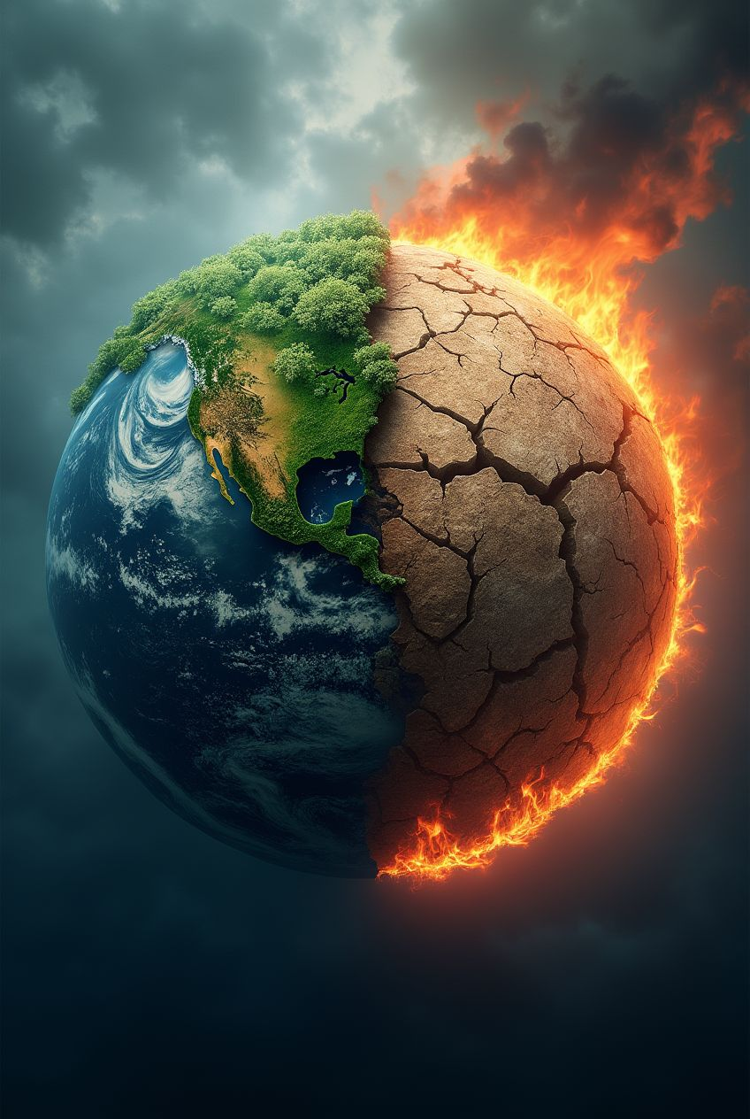
Climate Change and Its Impact
A brief presentation

Slide 2
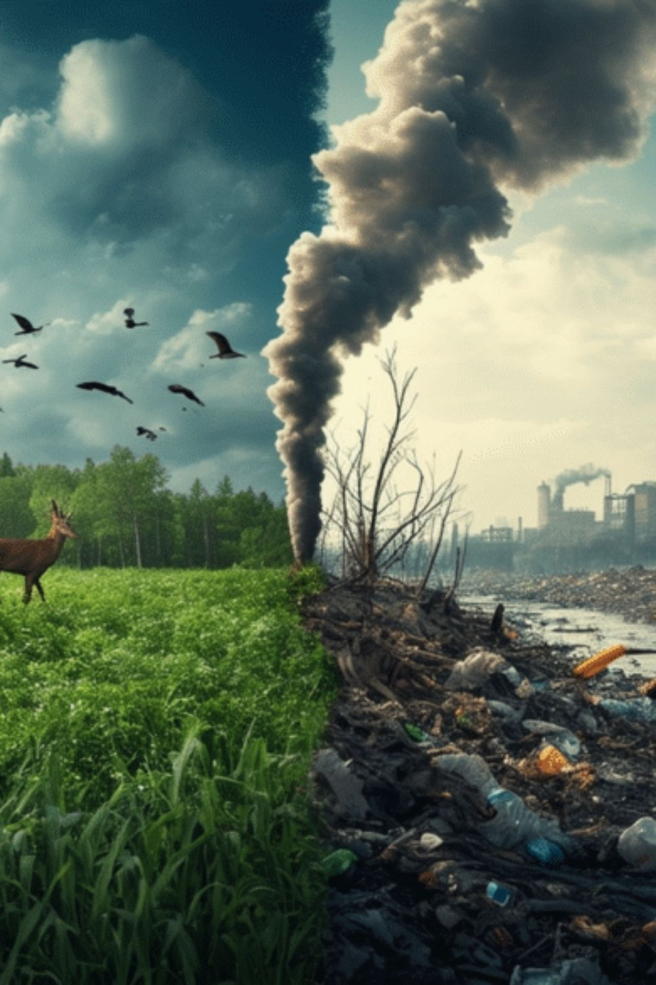
Causes of Climate Change

Slide 3

Effects of Climate Change
Some Key Effects:
Rising global temperatures
Melting glaciers & rising sea levels
Extreme weather events
Loss of biodiversity

Slide 4

Global Initiatives
Initiative | Description
Paris Agreement | Global treaty to limit global warming below 2°C.
UN Climate Action | Programs to promote renewable energy & sustainability.

Slide 5

Conclusion
Key Takeaways:
Climate change is real and urgent.
Everyone has a role to play in reducing its effects.
Sustainable practices and renewable energy are the future.

